Slide 1

Stage 5 Our Lady of Blessed Acceleration Course Designer: Eric Beerbaum
Our Lady of Blessed Acceleration is a 16 round, 80 point Comstock medium course. There are 8 USPSA targets. Box A is NOT a shooting area. The best two hits per target will score. The start signal is audible.
The Handgun start position is standing in box A, handgun loaded and holstered, wrists below belt. The PCC start position is standing in box A, PCC loaded, stock on belt, muzzle pointing at back berm.
On the audible start signal, engage all targets from within the shooting areas.

Slide 2
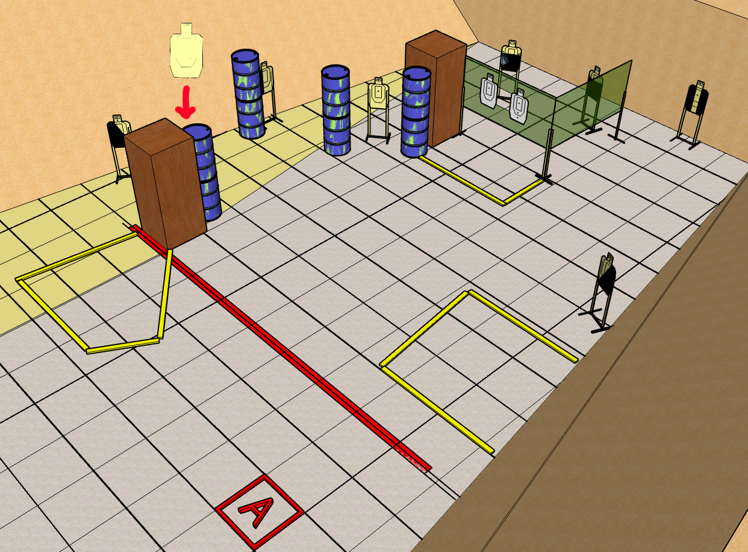
 | Stage 5 Our Lady of Blessed Acceleration Course Designer: Eric Beerbaum

